Slide 1

MATLAB Graphics: Basic Plots
Professor Bo Liu
James Watt School of Engineering

Slide 2
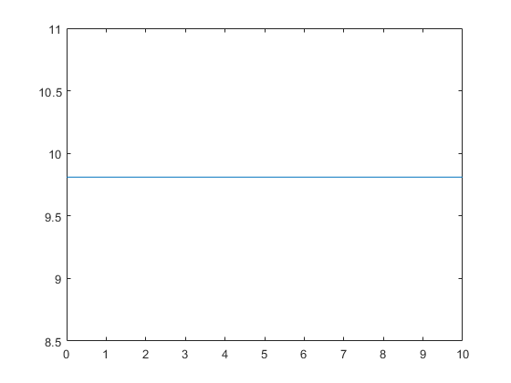
Example plot - 1
time = linspace(0, 10, 21); % matrix of 21 elements between 0 and 10
acceleration = 9.81 * ones(1, 21); % matrix of 21 elements equal to 9.81
plot(time, acceleration) % line plot
See live script for similar examples

Slide 3
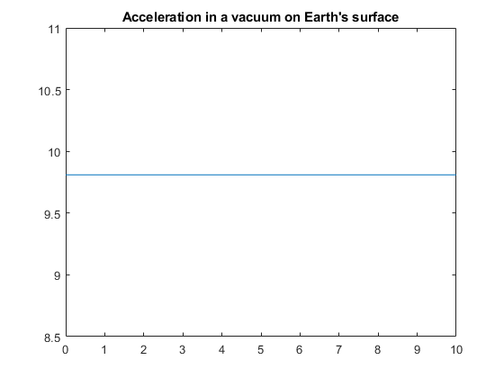
Example plot - 2
title("Acceleration in a vacuum on Earth's surface")
See live script for similar examples

Slide 4
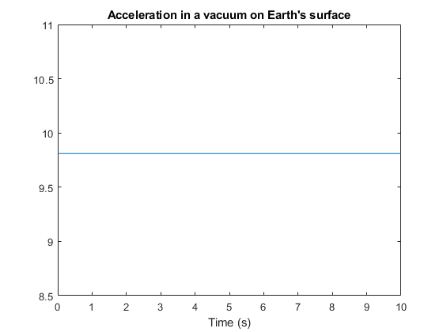
Example plot - 3
xlabel("Time (s)")
See live script for similar examples

Slide 5
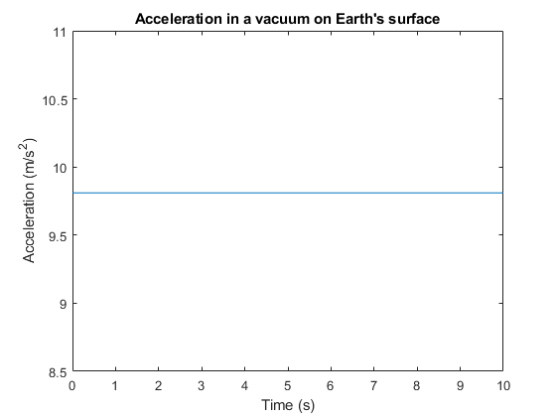
Example plot - 4
ylabel("Acceleration (m/s^2)")
See live script for similar examples

Slide 6

Example plot - 5
grid()
See live script for similar examples

Slide 7
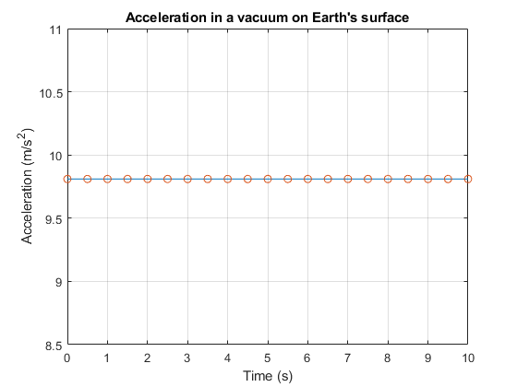
Example plot - 6
hold on % tell MATLAB to put next plots onto same figure
scatter(time, acceleration)
See live script for similar examples

Slide 8
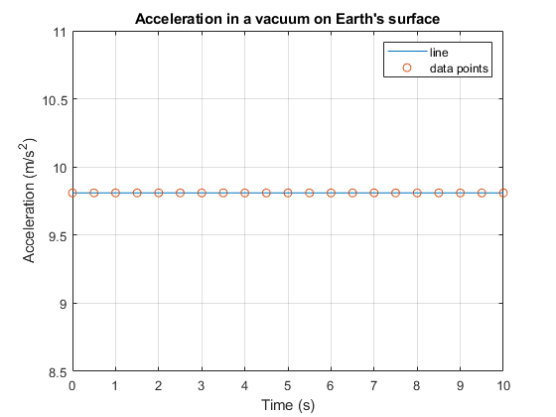
Example plot - 7
legend(["line", "data points"])
See live script for similar examples

Slide 9




Thanks!
#UofGWorldChangers
@UofGlasgow

Slide 10
Plot customization
MATLAB supports many ways of customizing plots.
The easiest way is to add other arguments to the “plot” function call.
Color | Marker | Line style
‘y’ → yellow | ‘.’ → point | ‘-’ → solid
‘m’ → magenta | ‘o’ → circle | ‘:’ → dotted
‘c’ → cyan | ‘x’ → x-mark | ‘-.’ → dashdot
‘r’ → red | ‘+’ → plus | ‘--’ → dashed
‘g’ → green | ‘*’ → star
‘b’ → blue | ‘s’ → square
‘w’ → white | ‘d’ → diamond
‘k’ → black | ‘v’ → triangle (down)

